Slide 1
RNN & LSTM

Slide 2
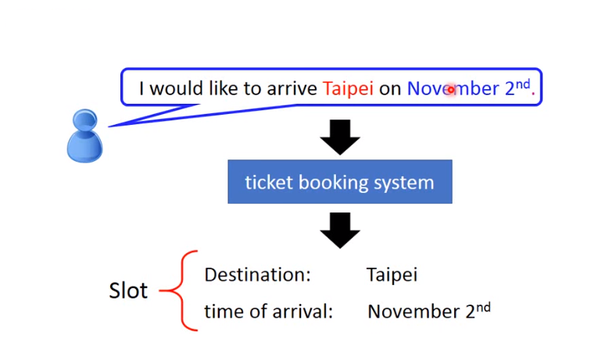
Example Application
Slot Filling

Slide 3
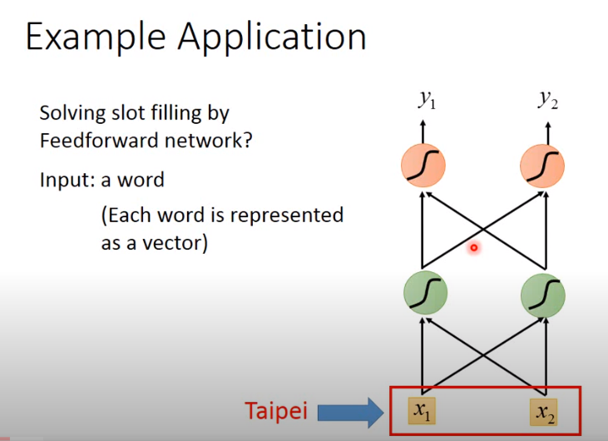
Example Application
Slot Filling

Slide 4
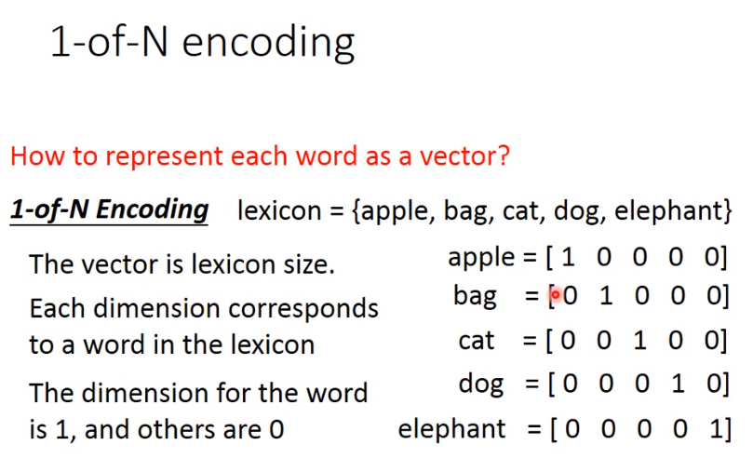
Example Application
Slot Filling

Slide 5
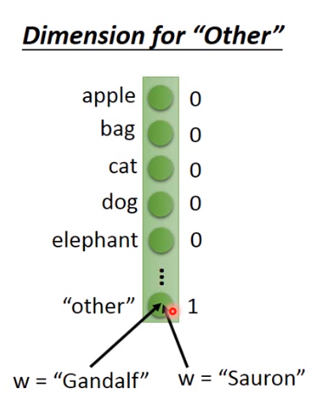
Example Application
Dimension of “other”

Slide 6
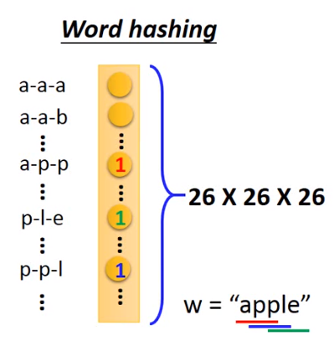
Example Application
Word hashing

Slide 7
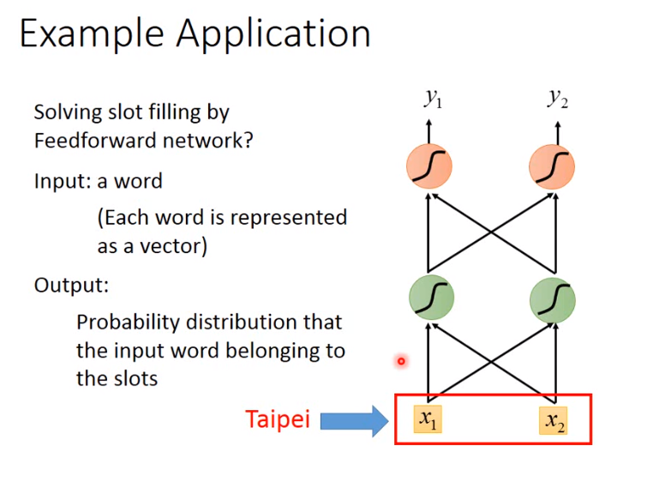
Example Application
Slot filling

Slide 8
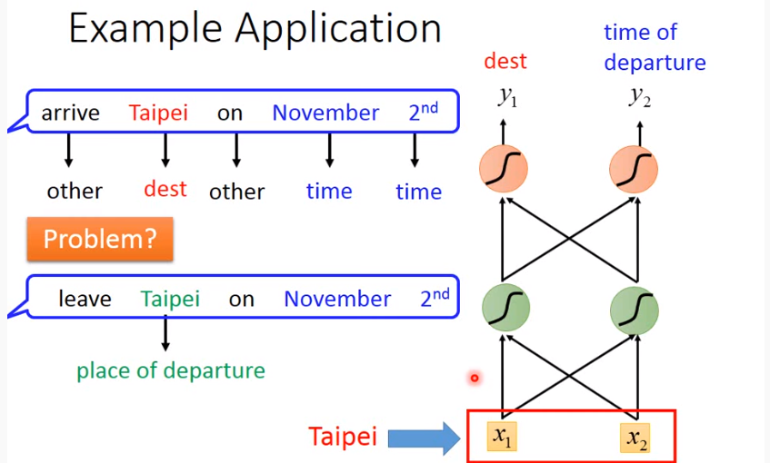
Example Application
Problem

Slide 9
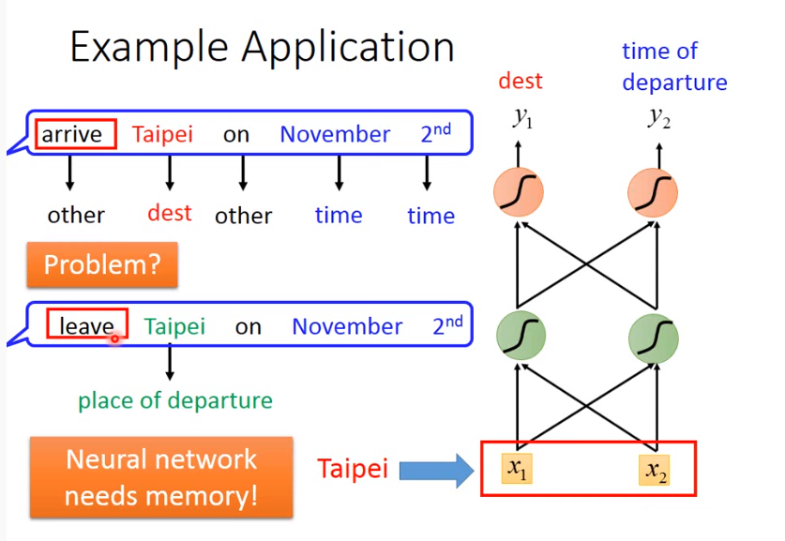
Example Application
Problem

Slide 10
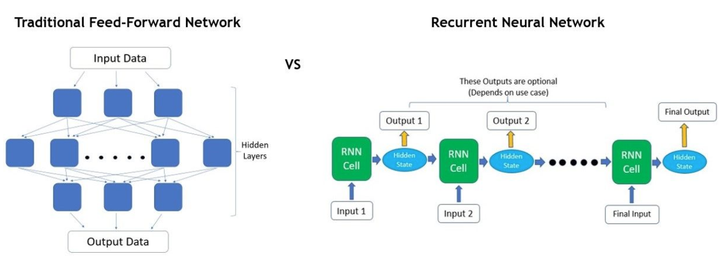
Recurrent Neural Network(RNN)

Slide 11
Recurrent Neural Network(RNN)
RNNs take them in one at a time and in a sequence.
At each step, the RNN does a series of calculations before producing an output.
The output, known as the hidden state, is then combined with the next input in the sequence to produce another output.
This process continues until the model is programmed to finish or the input sequence ends.

Slide 12
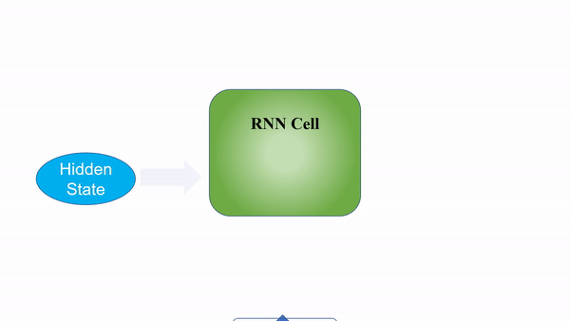
Recurrent Neural Network(RNN)

Slide 13
Recurrent Neural Network(RNN)
the calculations at each time step consider the context of the previous time steps in the form of the hidden state.
Being able to use this contextual information from previous inputs is the key essence to RNNs’ success in sequential problems.

Slide 14

RNNs’ Outputs

Slide 15
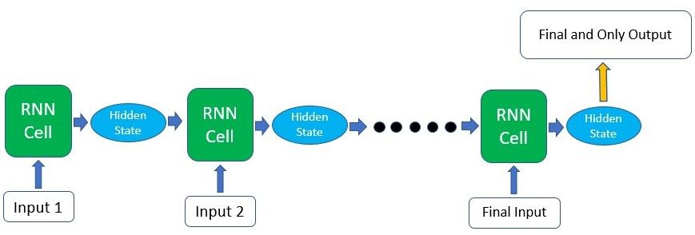
RNNs’ Outputs

Slide 16
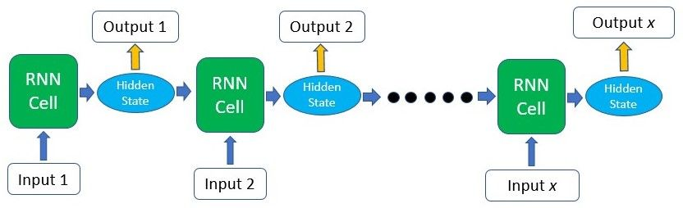
RNNs’ Outputs

Slide 17
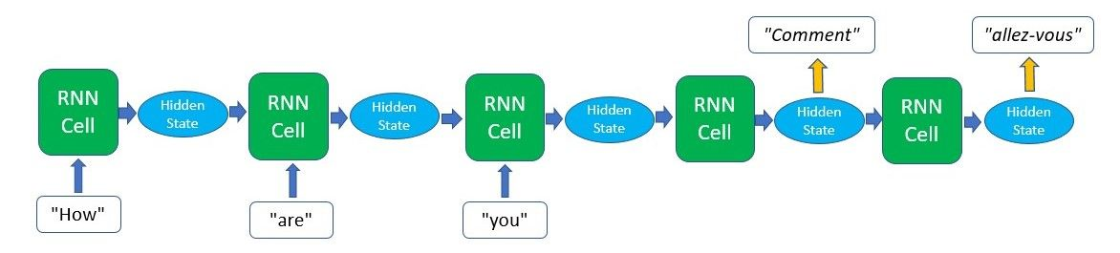
RNNs’ Outputs

Slide 18
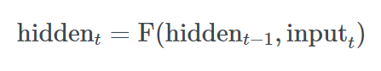
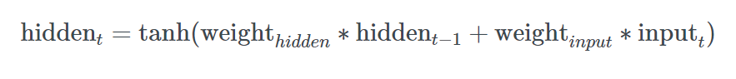
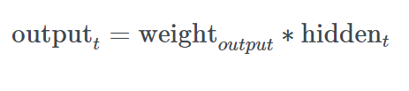
Simple RNN

Slide 19
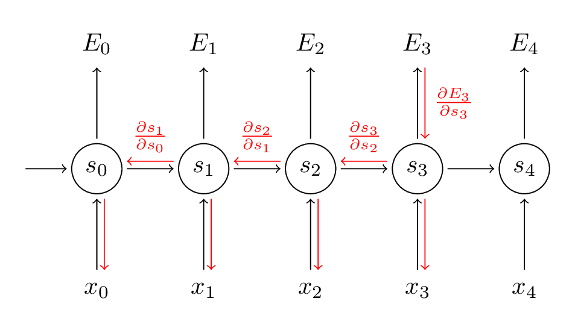
Training RNN

Slide 20
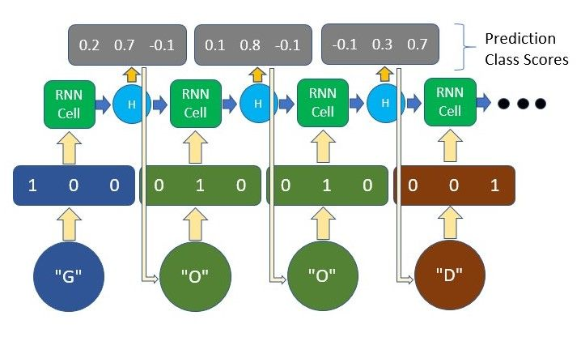
Training RNN

Slide 21
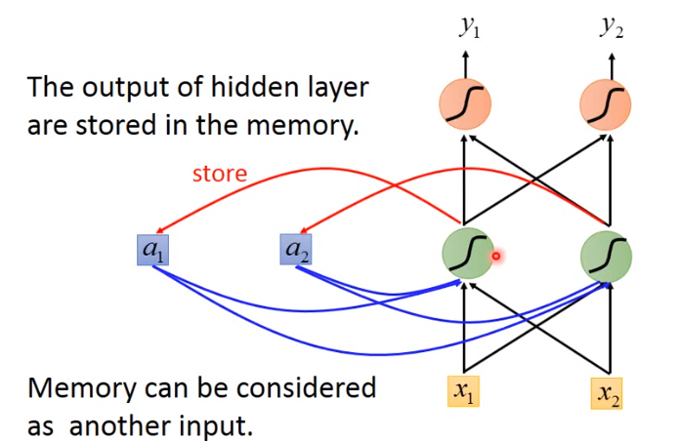
Recurrent Neural Network(RNN)

Slide 22
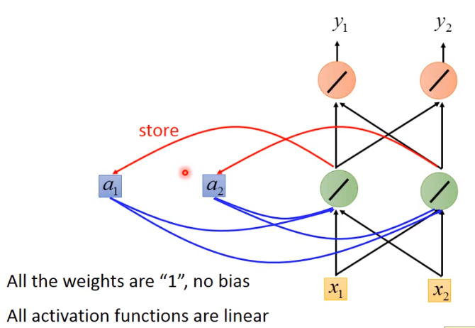
RNN Example

Slide 23
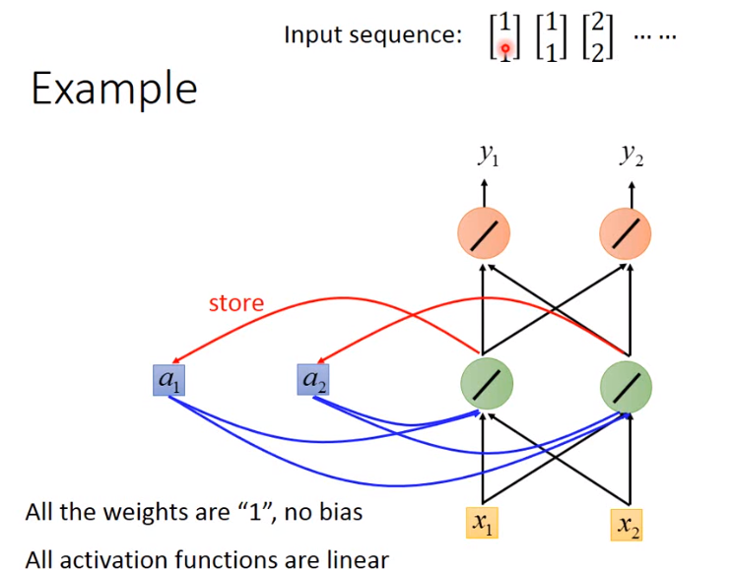
RNN Example

Slide 24
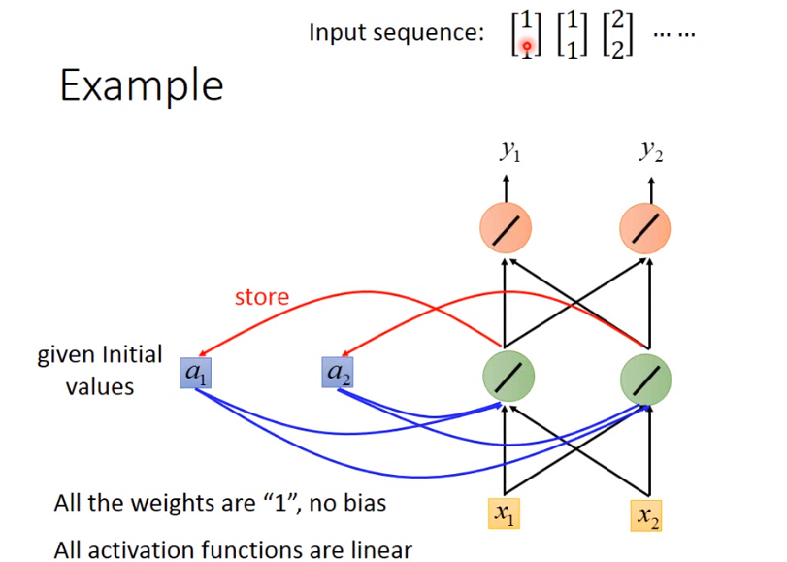
RNN Example

Slide 25
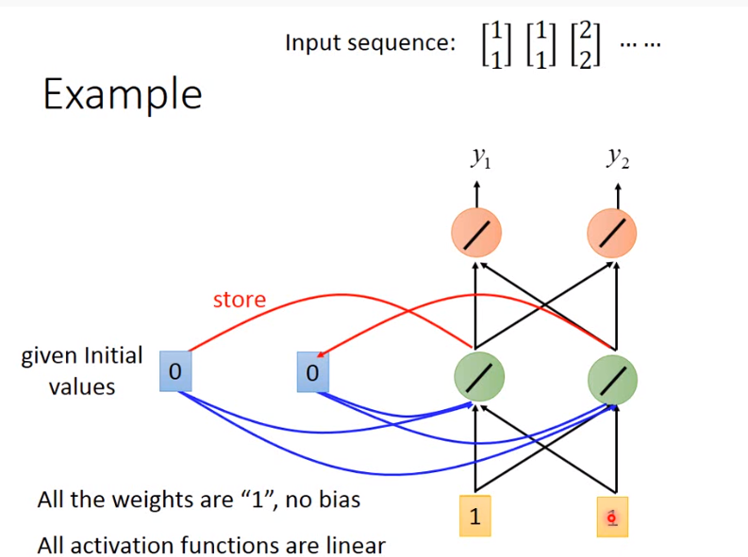
RNN Example

Slide 26
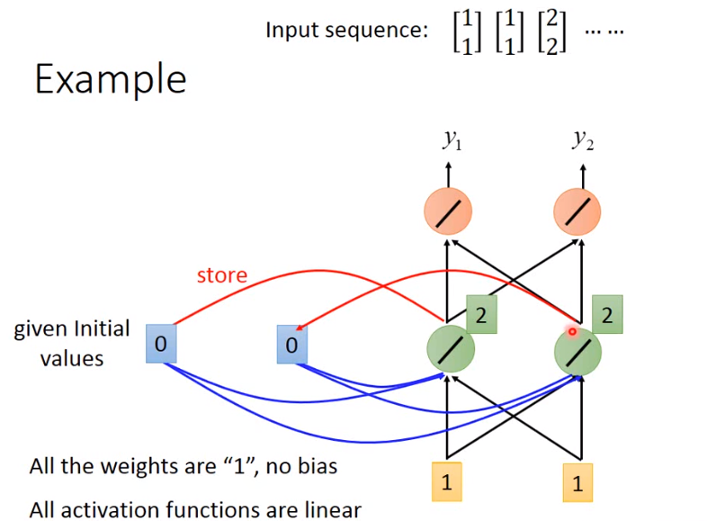
RNN Example

Slide 27
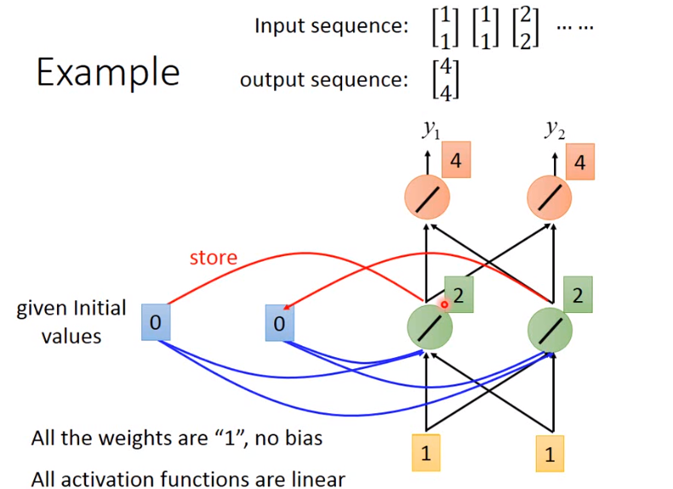
RNN Example

Slide 28
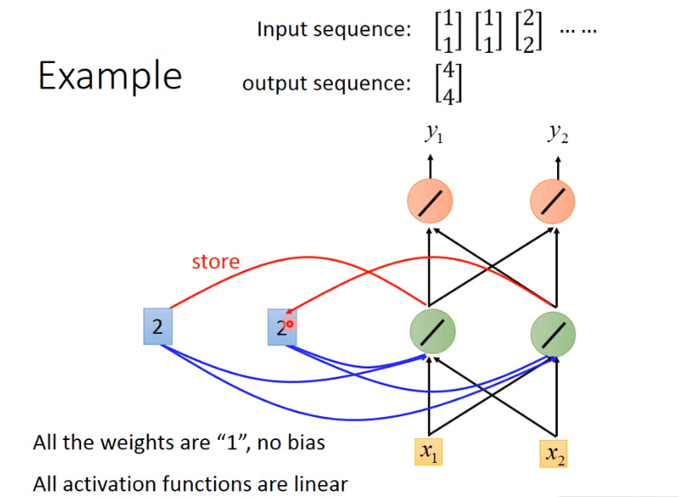
RNN Example

Slide 29
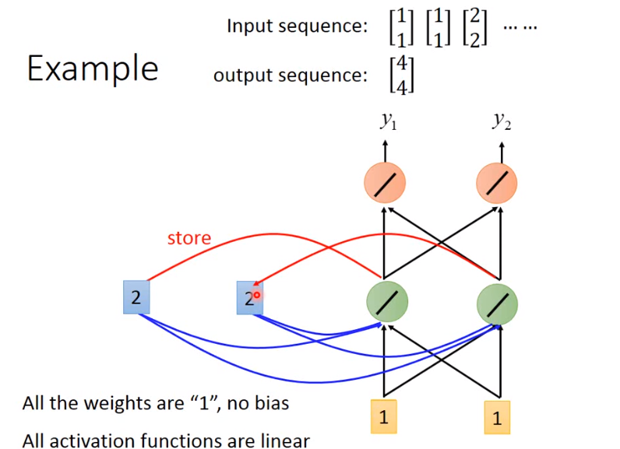
RNN Example

Slide 30
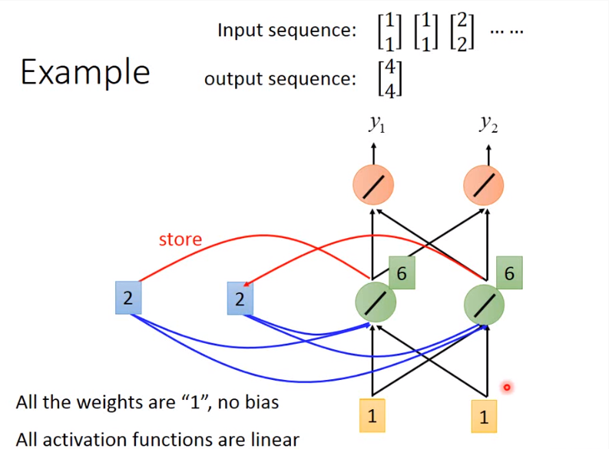
RNN Example

Slide 31
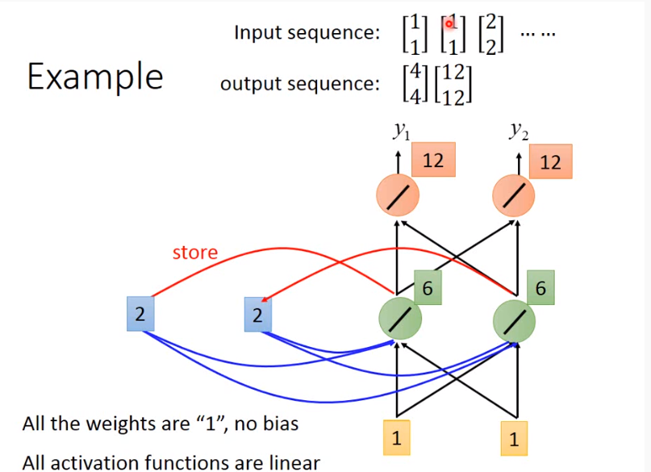
RNN Example

Slide 32
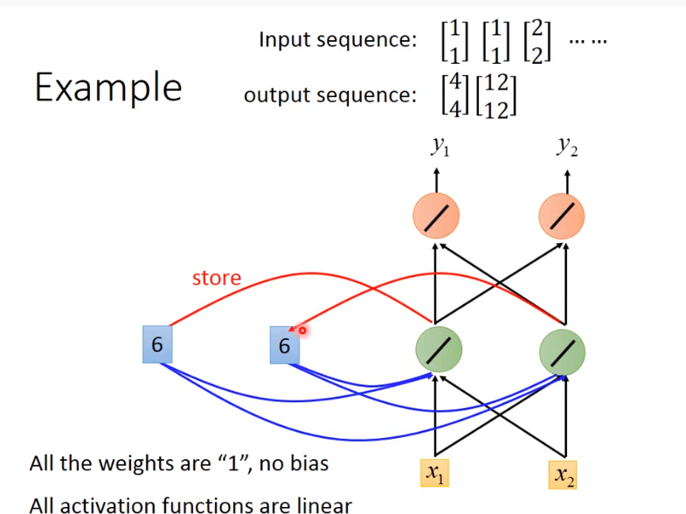
RNN Example

Slide 33
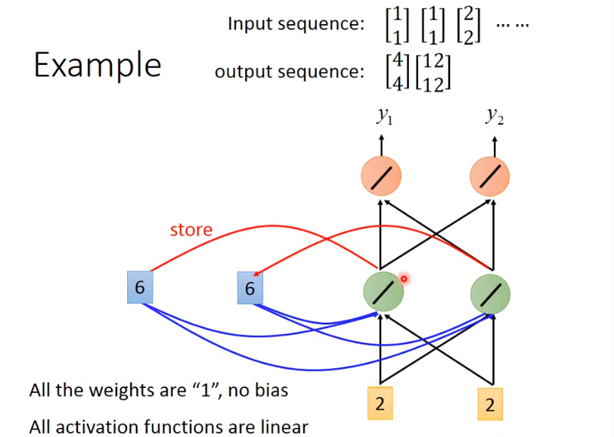
RNN Example

Slide 34
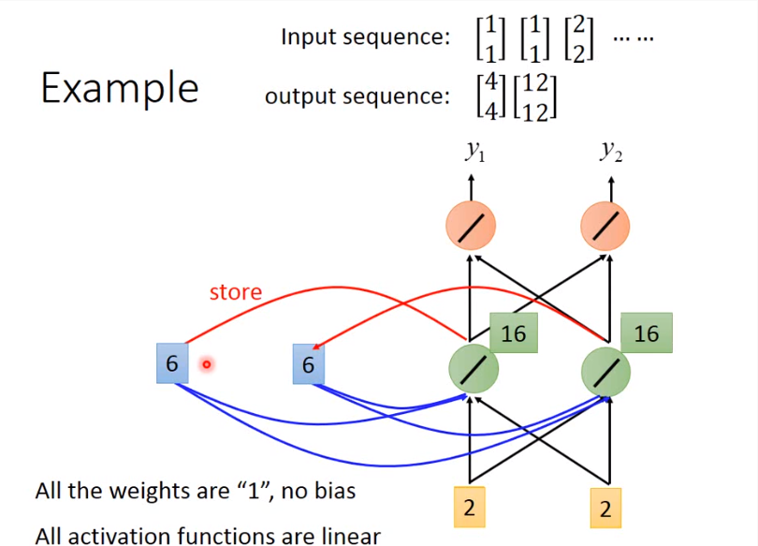
RNN Example

Slide 35
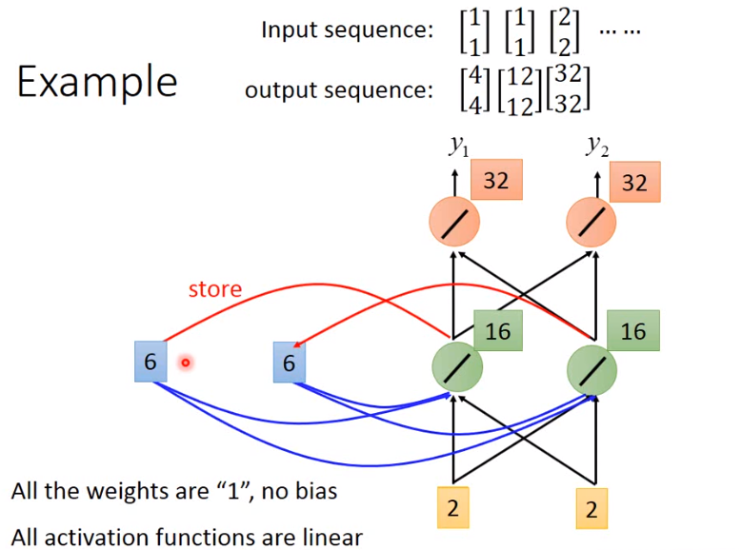
RNN Example

Slide 36
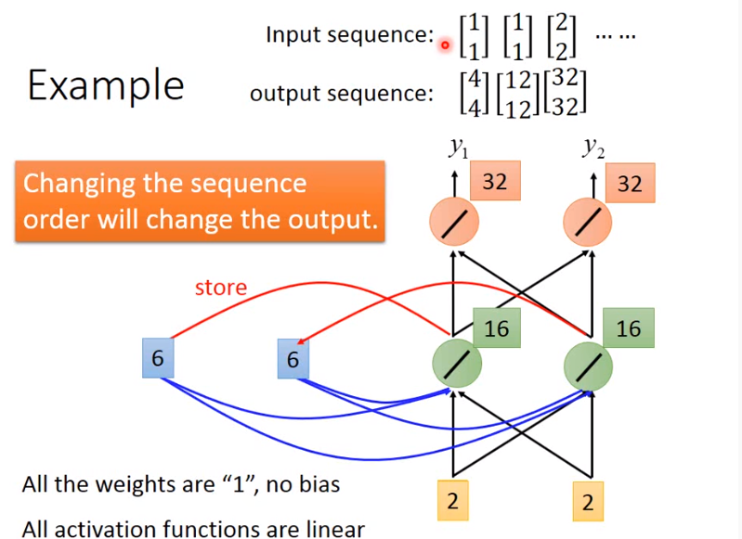
RNN Example

Slide 37
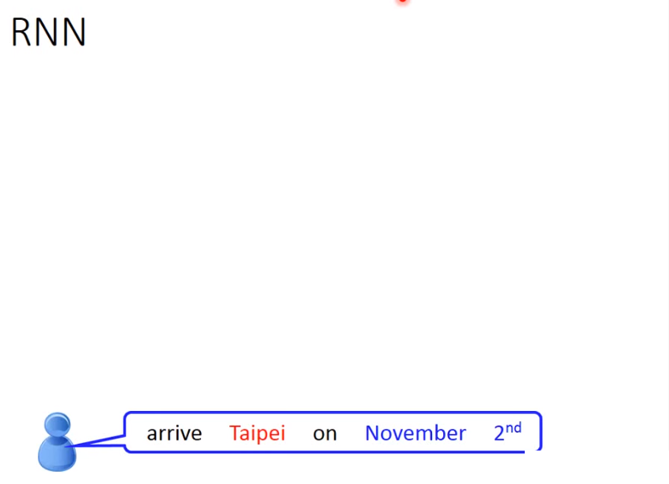
RNN on slot filling

Slide 38
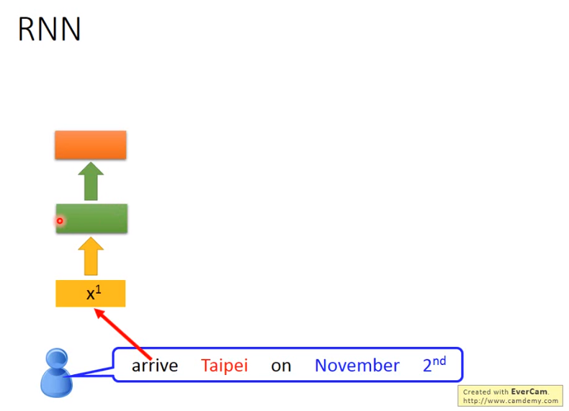
RNN on slot filling

Slide 39
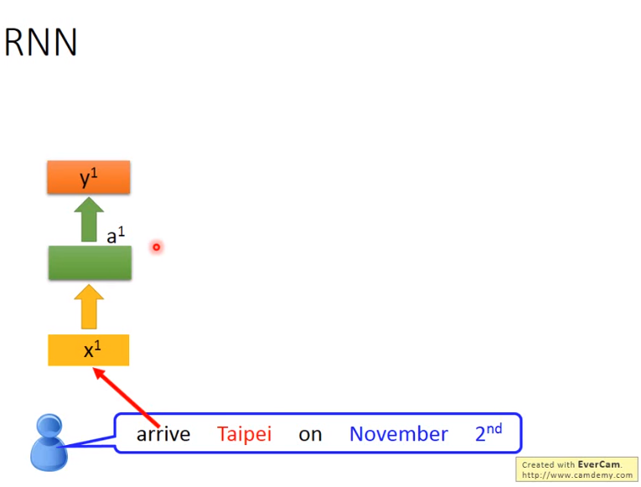
RNN on slot filling

Slide 40
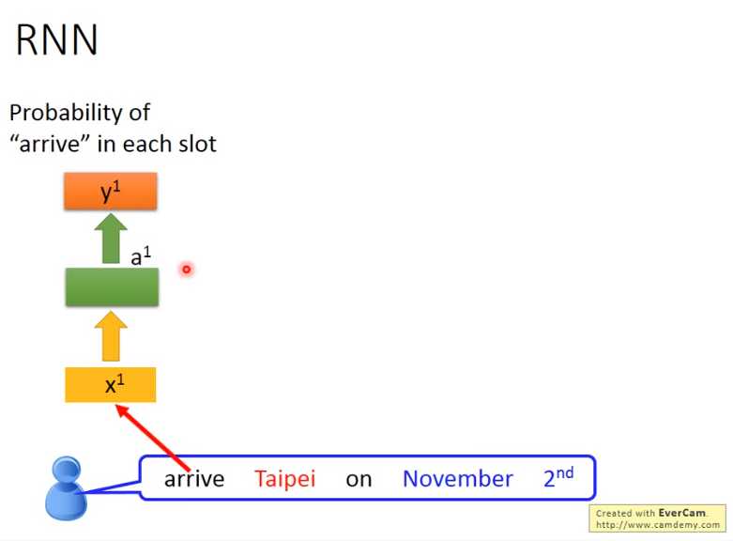
RNN on slot filling

Slide 41
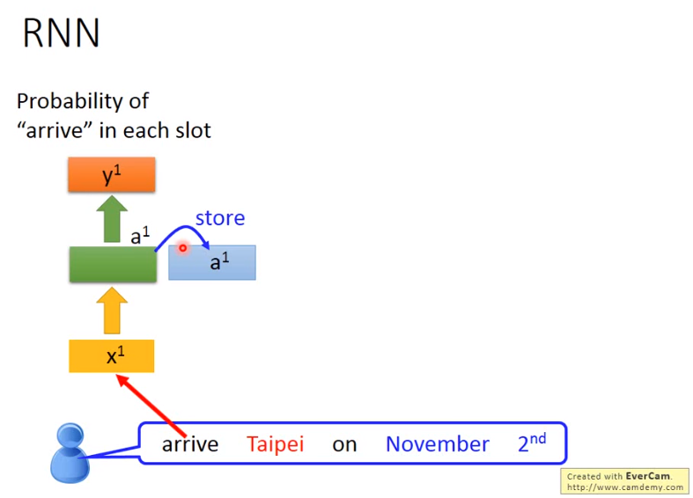
RNN on slot filling

Slide 42
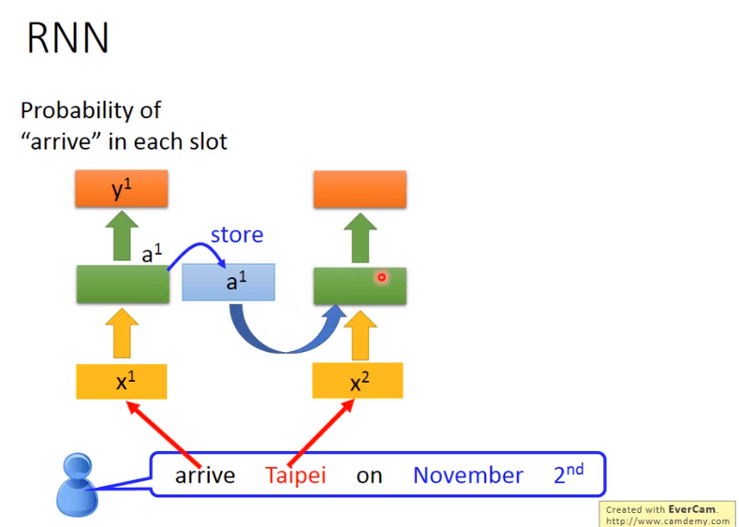
RNN on slot filling

Slide 43
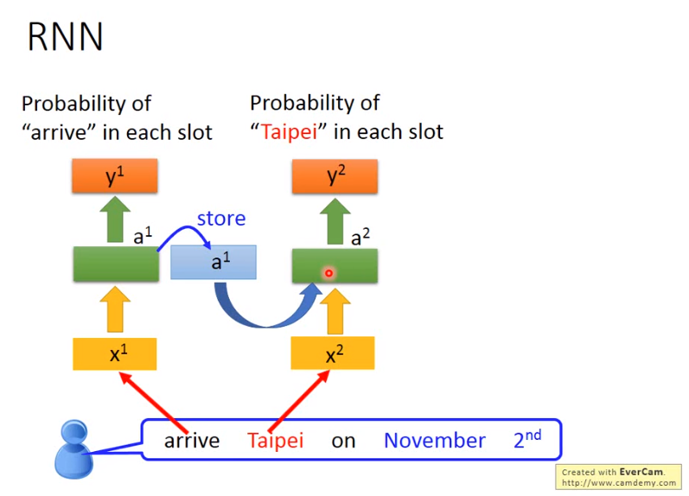
RNN on slot filling

Slide 44
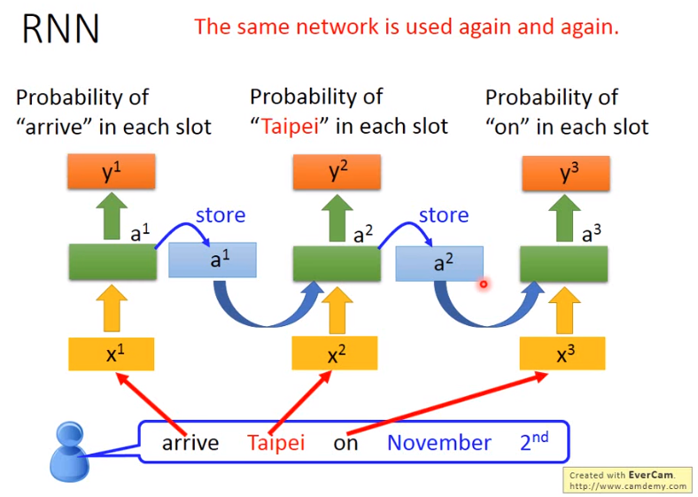
RNN on slot filling

Slide 45
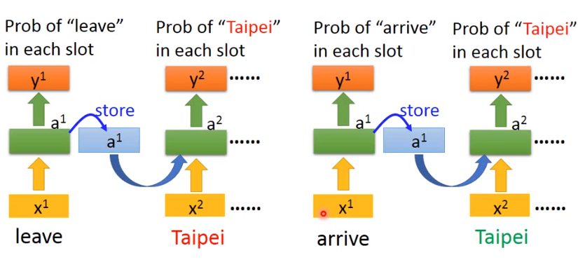
RNN on slot filling

Slide 46
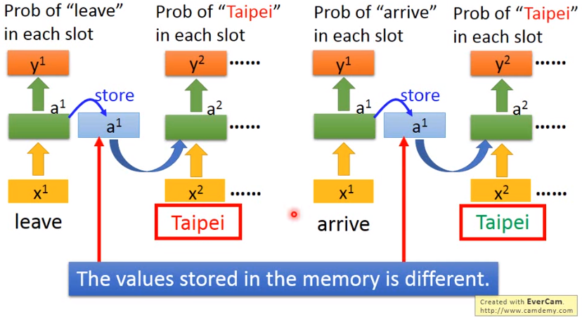
RNN on slot filling

Slide 47
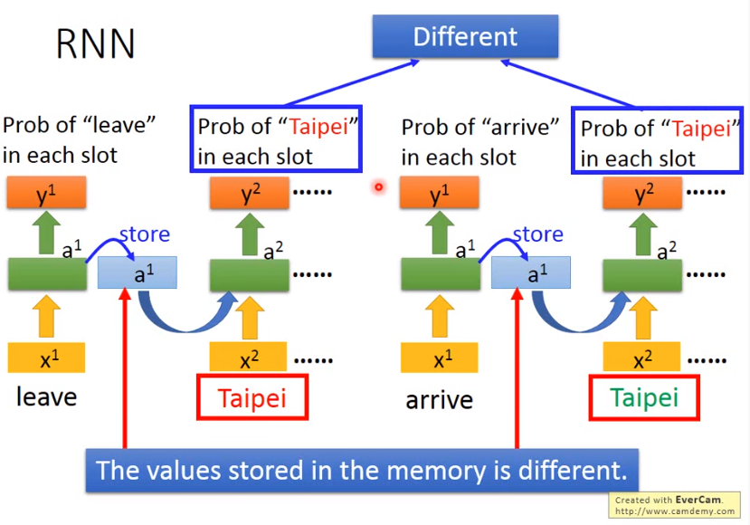
RNN on slot filling

Slide 48
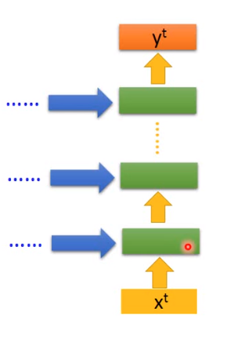
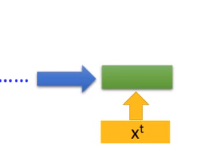
Deep RNN

Slide 49
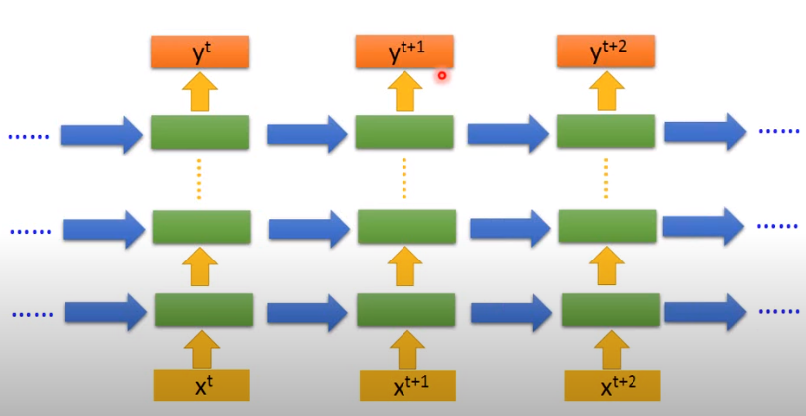
Deep RNN

Slide 50
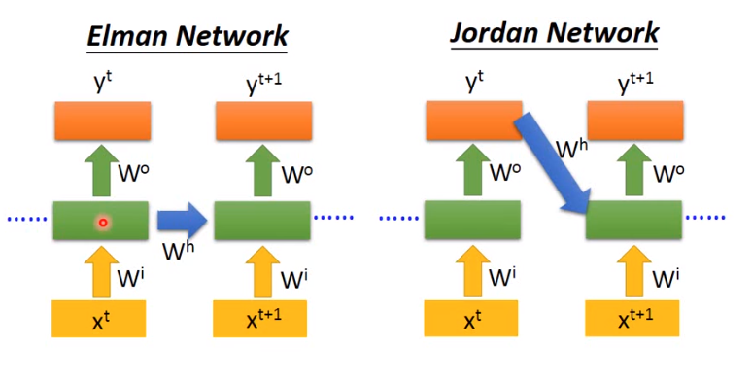
Elman & Jordan Network

Slide 51
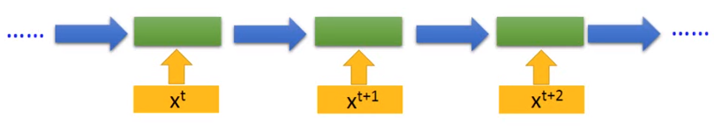
Single Directional RNN

Slide 52

Single Directional RNN

Slide 53

Bidirectional RNN

Slide 54
Long Short-Term Memory (LSTM)

Slide 55

LSTM

Slide 56

LSTM

Slide 57

LSTM

Slide 58

LSTM

Slide 59

LSTM

Slide 60

LSTM

Slide 61

LSTM

Slide 62

LSTM

Slide 63

LSTM

Slide 64

LSTM

Slide 65

LSTM

Slide 66

LSTM

Slide 67

LSTM

Slide 68

LSTM

Slide 69

LSTM

Slide 70

LSTM

Slide 71

LSTM

Slide 72

LSTM

Slide 73

LSTM

Slide 74

LSTM

Slide 75

LSTM

Slide 76

LSTM

Slide 77

LSTM

Slide 78

LSTM

Slide 79

和一般的nn有何不同

Slide 80

和一般的nn有何不同

Slide 81

和一般的nn有何不同

Slide 82

和一般的nn有何不同

Slide 83

和一般的nn有何不同

Slide 84

和一般的nn有何不同

Slide 85

和一般的nn有何不同

Slide 86

和一般的nn有何不同

Slide 87

和一般的nn有何不同

Slide 88

真正的LSTM

Slide 89
最重要的3個輸入值
輸入值：每一個x值
短期記憶體：Hidden state/short-term memory
長期記憶體：Cell state/long-term memory

Slide 90
最重要的3個門
輸入門：Input gate
遺忘門：Forget gate
輸出門：Output gate

Slide 91


最重要的2個函數
決定門是否開啟：Sigmoid
將值進行處理：tanh

Slide 92




真正的LSTM

Slide 93


真正的LSTM

Slide 94



真正的LSTM

Slide 95

程式中的LSTM

